Slide 1


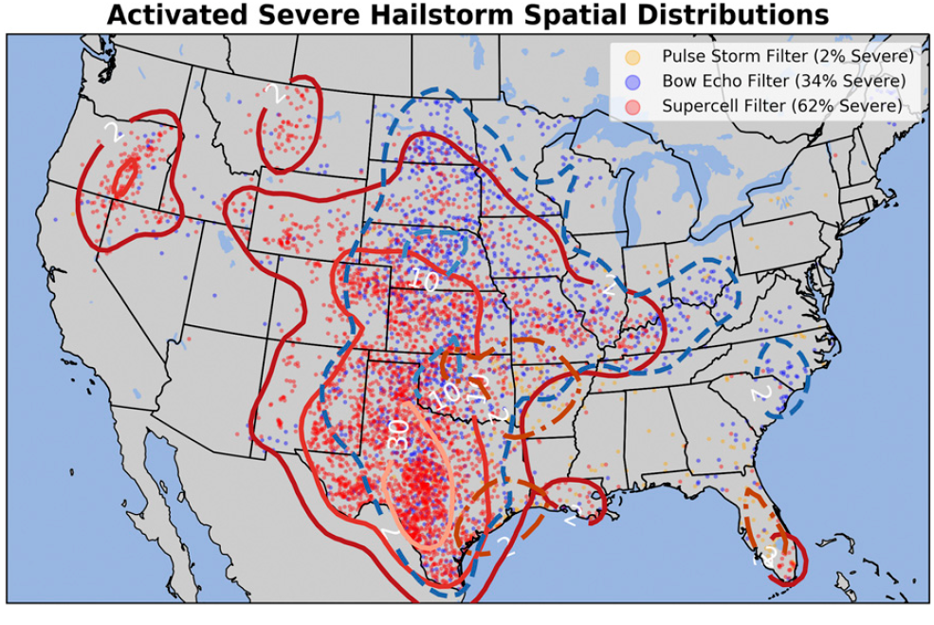
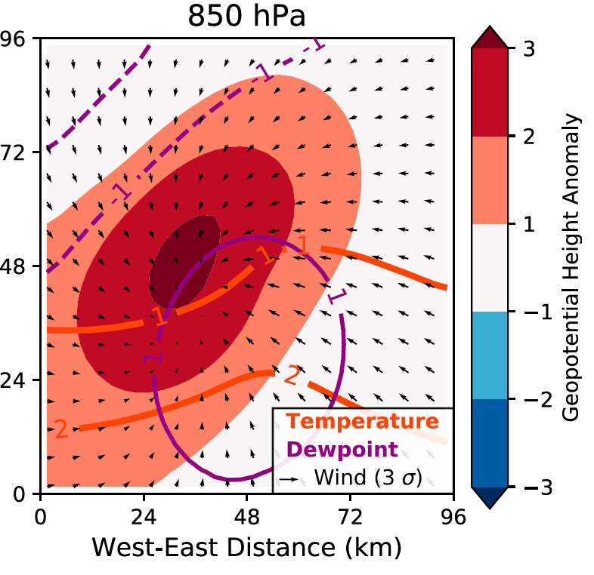
ML for Earth & Env Sci (Week 7, SP2022)
How can we better understand and communicate our ML predictions?
(Left) Which neurons activate? (Right) Which patterns maximize the probability of severe hail?
Source: Gagne et al. (2019)
Notes:
COSERO hydrological model

Slide 2

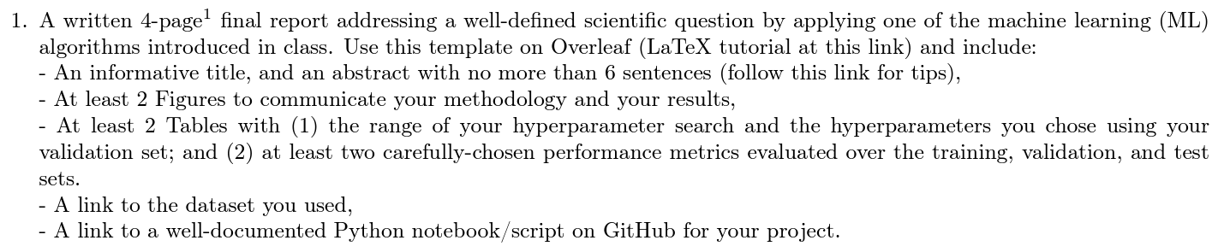
In-class Peer Review: Wed, Dec 14th , 1PM-3PM
Please use the same GitHub username as you used to fork the course’s repository
Submit first draft of your project by Tue, Dec 13th
Friday Office Hours: Bring your code, no Zoom

Slide 3
Final Presentations on Friday, Dec 16th (Moodle) Please email me if you have not yet registered
4min presentations + 1min Q&A
Tip = 1 slide/minute
Scientific question: What’s our goal and why do we care?
Dataset: Characteristics, challenges, training/validation/test split, etc.
Methodology: Which ML algorithm(s) did you choose and why?
Results: What are your findings and how does it answer the sci. question?

Slide 4
Min 20-45: Intro to XAI = eXplainable Artificial Intelligence
Learning Objectives (Molnar extracts):
Understand the importance of XAI
Distinguish local from global explanation methods
Distinguish model-agnostic from model-specific methods
Know how to implement permutation feature importance and partial dependence plots
Apprehend explanation methods for neural networks

Slide 5
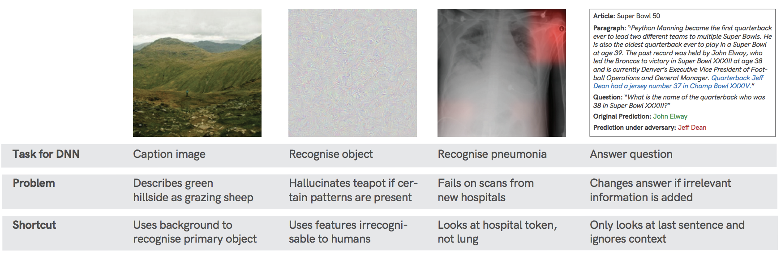
Why bother with XAI?
Environmental examples from students
Horse/label
Would you trust the model
Source: Geirhos et al. (2020) arXiv:2004.07780.

Slide 6
Why bother with XAI? Because NNs take shortcuts!
Environmental examples from students
Horse/label
Would you trust the model
Source: Geirhos et al. (2020) arXiv:2004.07780.

Slide 7
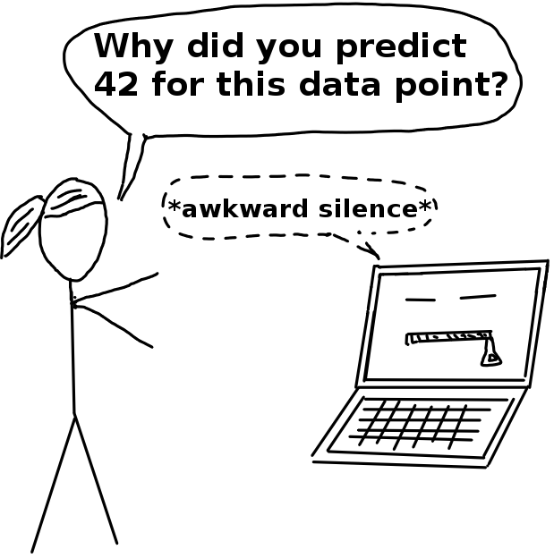
Interpretability = Degree to which a human can understand the cause of a decision
Advantages of XAI: Robustness, Trustworthiness, Scientific Insight
understanding why a wildfire happens is crucial for its management
In land use classification it is important to know based on which criteria the algorithm made a decision
For rockfalls the reasons the models predicts something may be even more important then know when and where it might happen. This is because we can then treat the cause for the rockfalls instead of the reasons for it.
spam email detection
when the outcome of the model has no importance
Source: Interpretable Machine Learning, C. Molnar (2019)

Slide 8
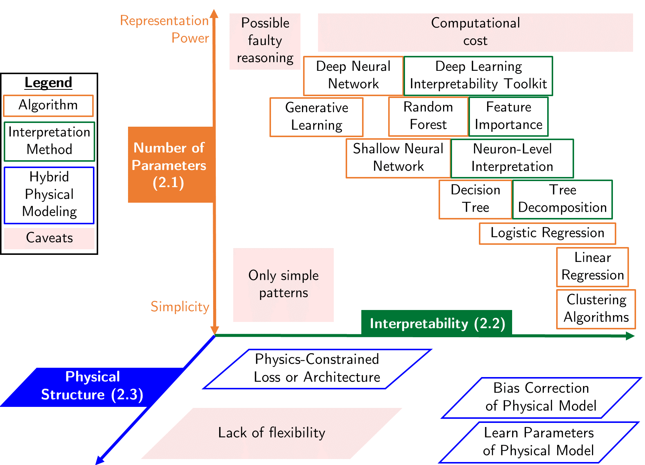
Some algorithms are inherently interpretable
Example: Linear regression with one output and two inputs
Naive: Read coefficients
Feature importance:
(One sample) Compare terms
(Entire set) Average absolute terms over the entire set
Source: Beucler et al. (2021)

Slide 9
Local (sample-level) ≠ Global Explanation
Ensemble mean of absolute values
Feature importance:
(One sample) Compare terms
(Entire set) Average absolute terms over the entire set
Source: Beucler et al. (2021)

Slide 10
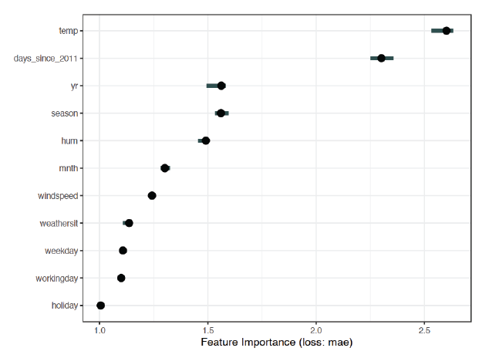
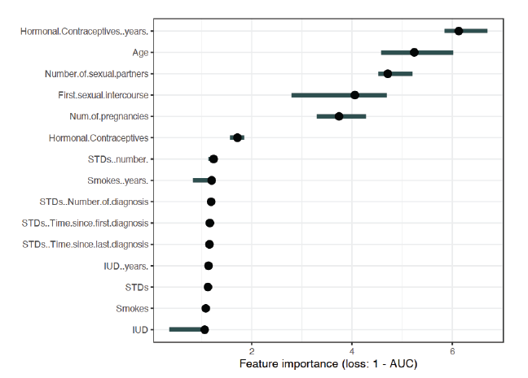
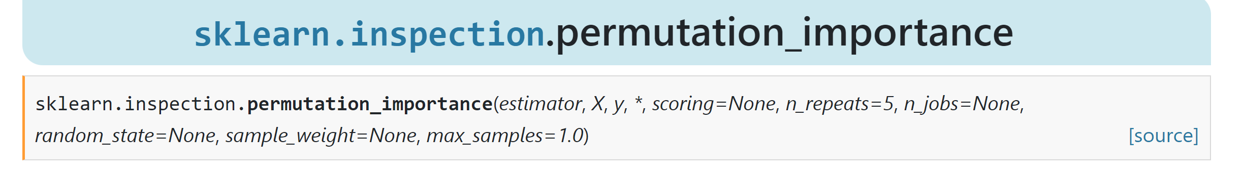
Permutation feature importance = Increase in prediction error in response to feature permutation
temp
Predicting bike counts with SVM
⚠️holiday
For your project: Calculate random PFI on test data using e.g., scikit-learn
Notes:
Example of Global explanation

Slide 11
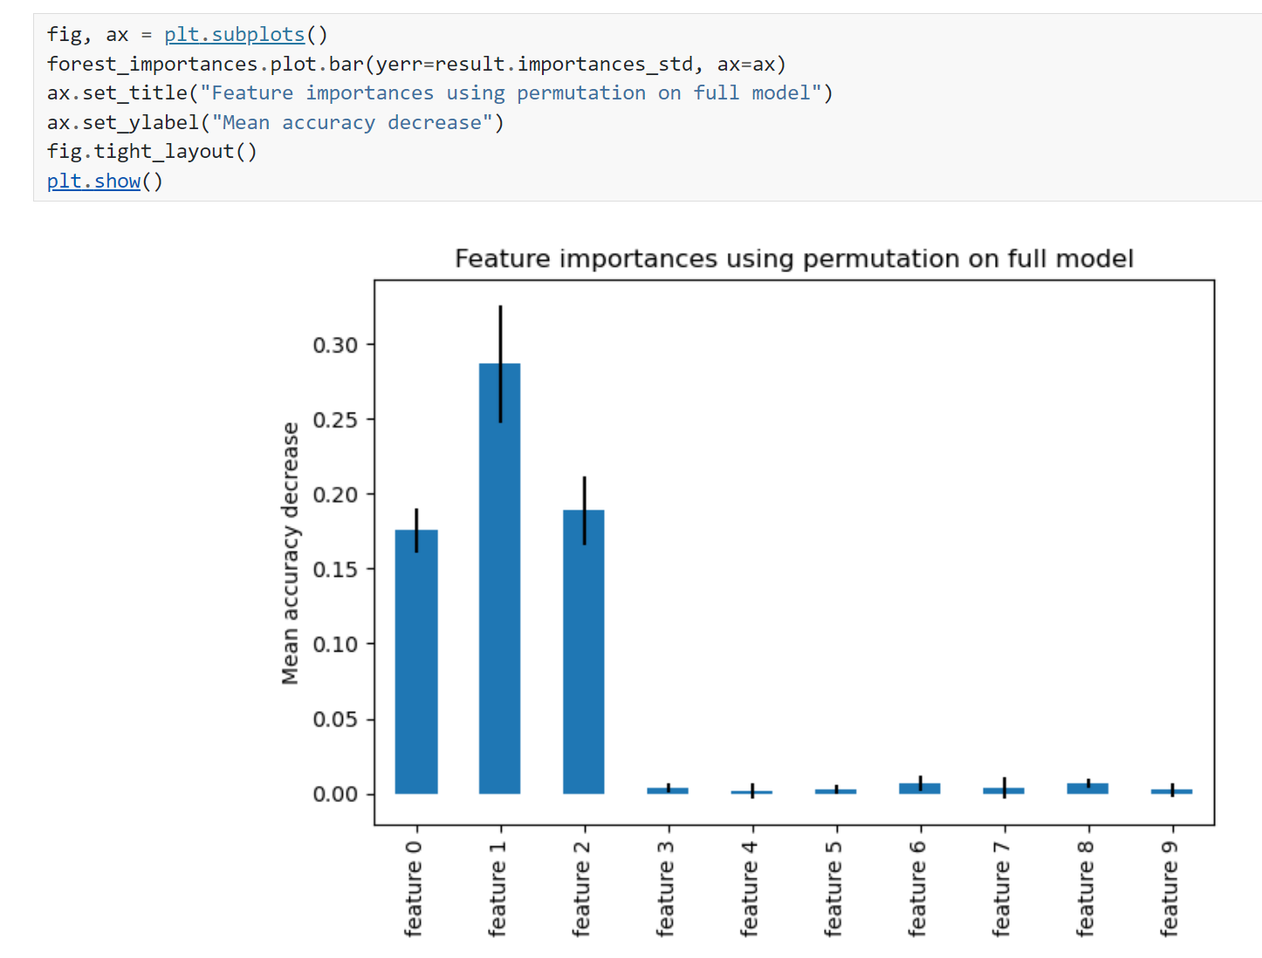
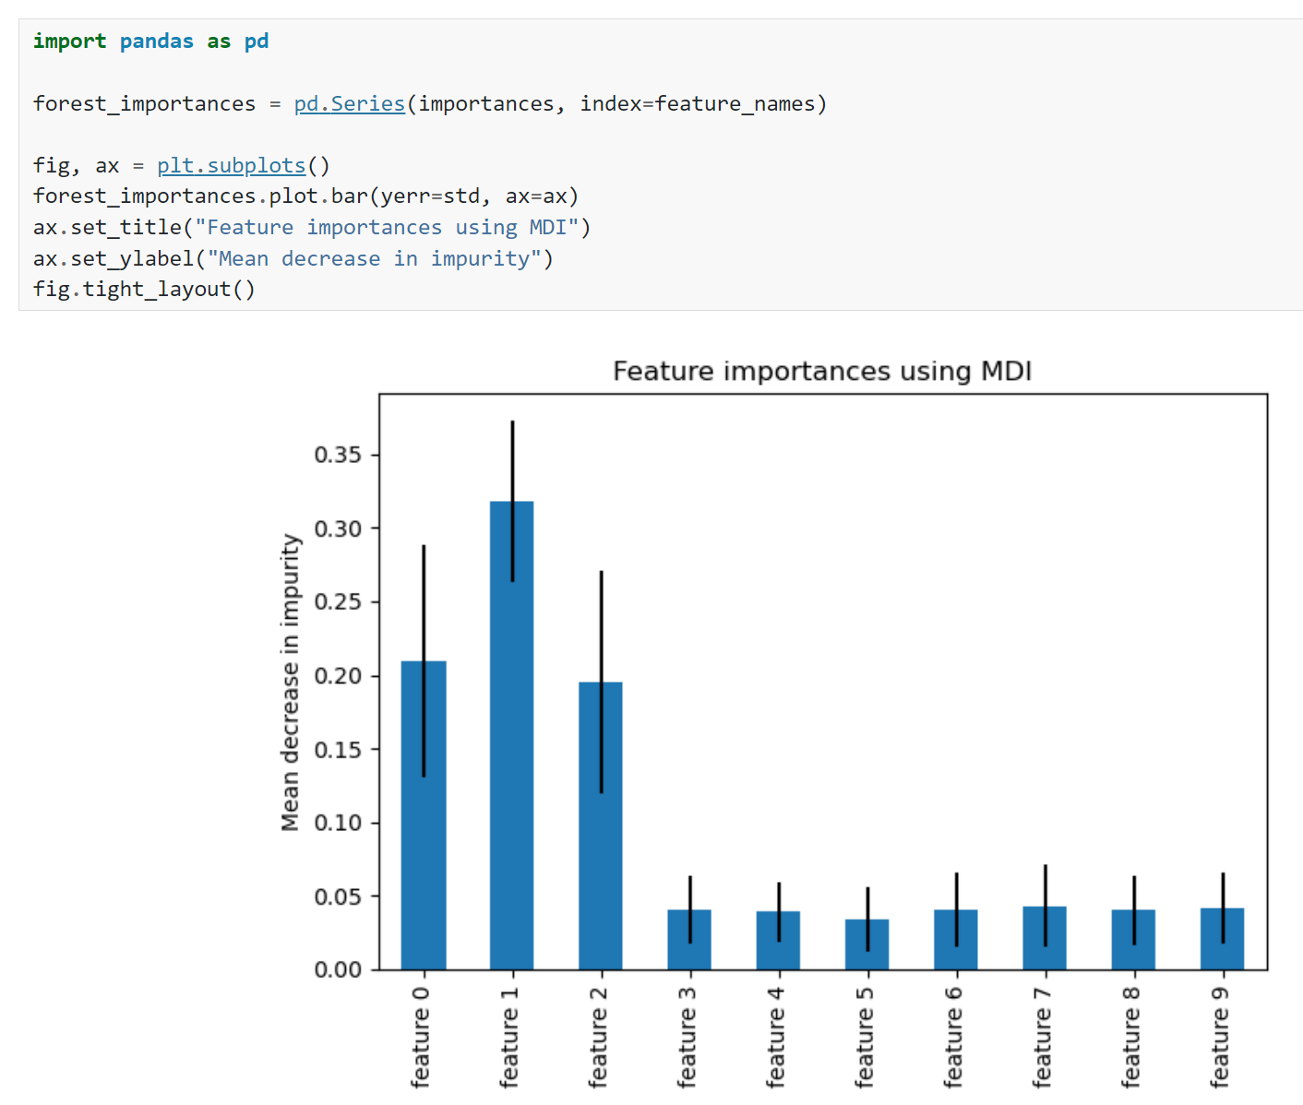
Model-agnostic versus model-specific explanation Example: Random forests (see final project)
Random
Feature
Permutation
Mean Decrease Impurity
Source: https://scikit-learn.org/stable/auto_examples/ensemble/plot_forest_importances.html
Notes:
Vote ☺

Slide 12
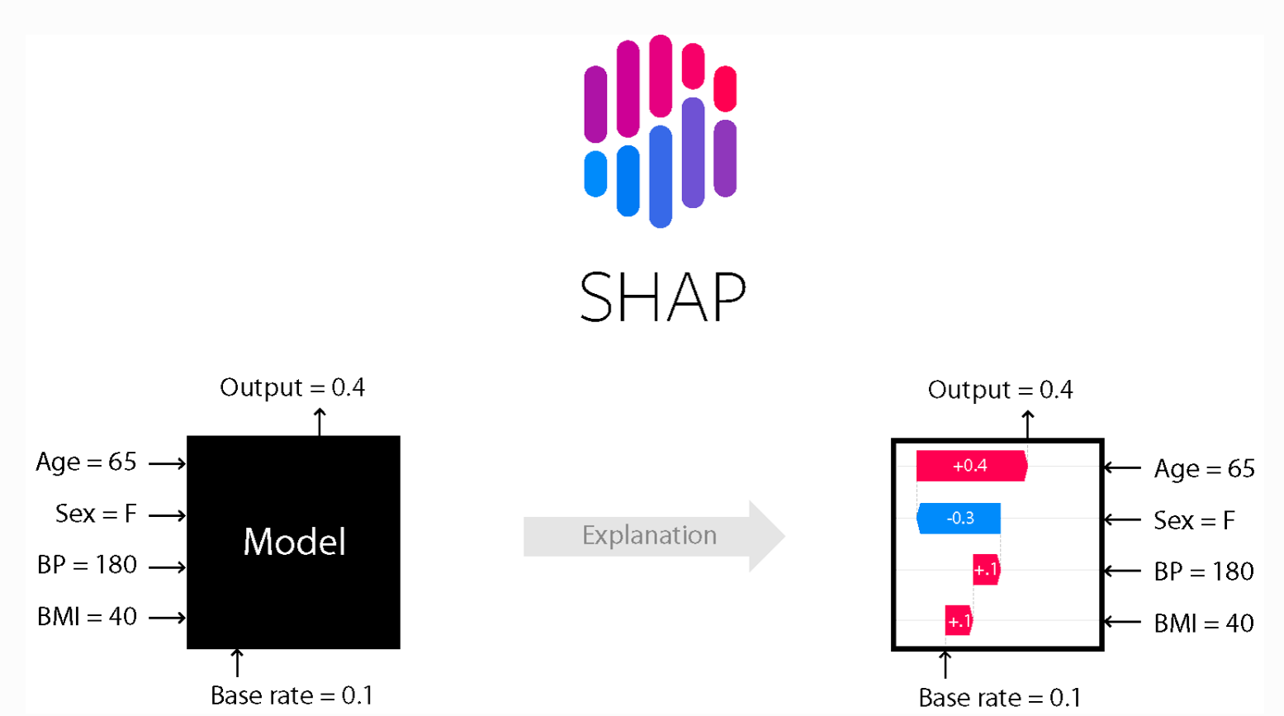
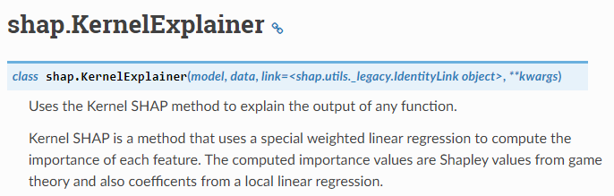
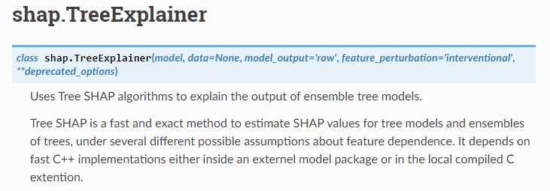
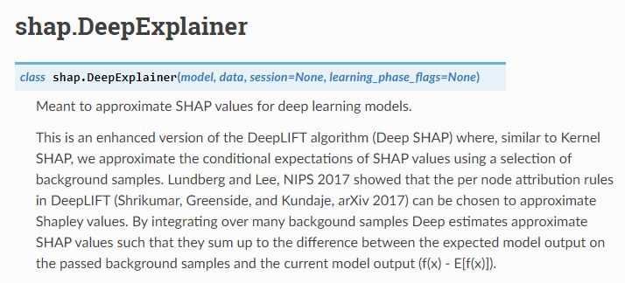
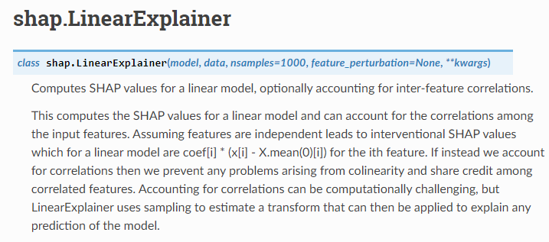
Model-agnostic versus model-specific explanation Example 2: SHAPley values
Source: Shapley (1951), https://shap.readthedocs.io/en/latest/

Slide 13
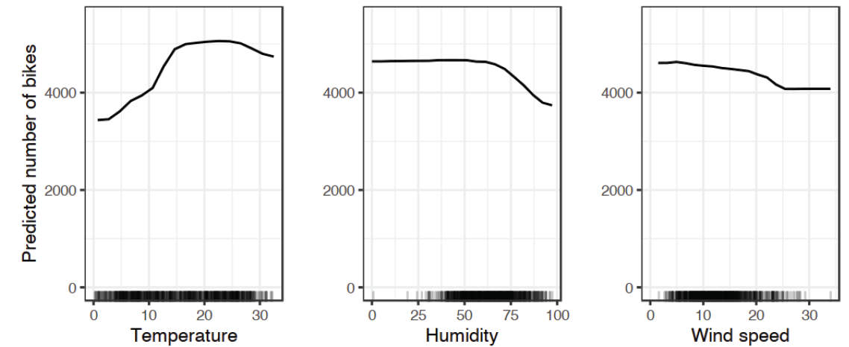


Partial Dependence Plots “show the marginal effect of 1 or 2 inputs on the predicted outputs”

Slide 14

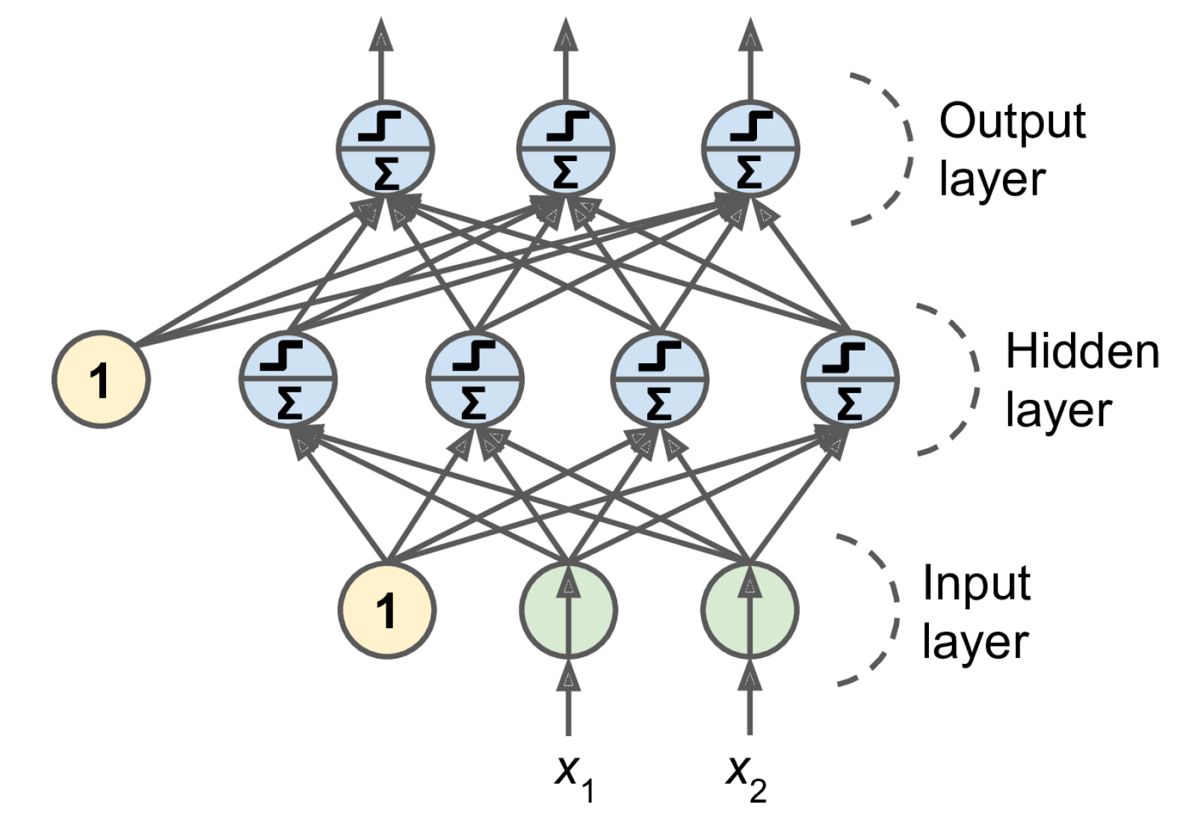
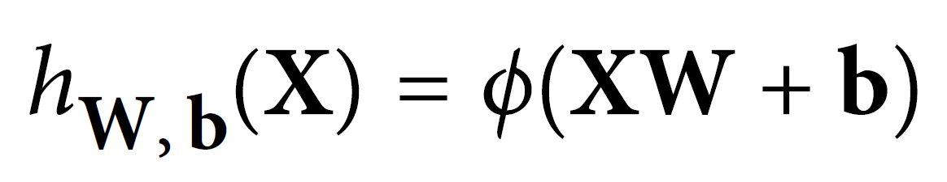
3 weeks ago = general case: Artificial Neural Networks
Notes:
1 layer = similar to logistic regression
2 layers = shallow neural network
Deep learning = 3 layers and above

Slide 15


2 weeks ago = Convolutional Neural Networks (CNNs)
Regularized versions of Artificial Neural Networks used to process images
Source: Giphy, Analytics India Magazine (K. Maladkar)

Slide 16
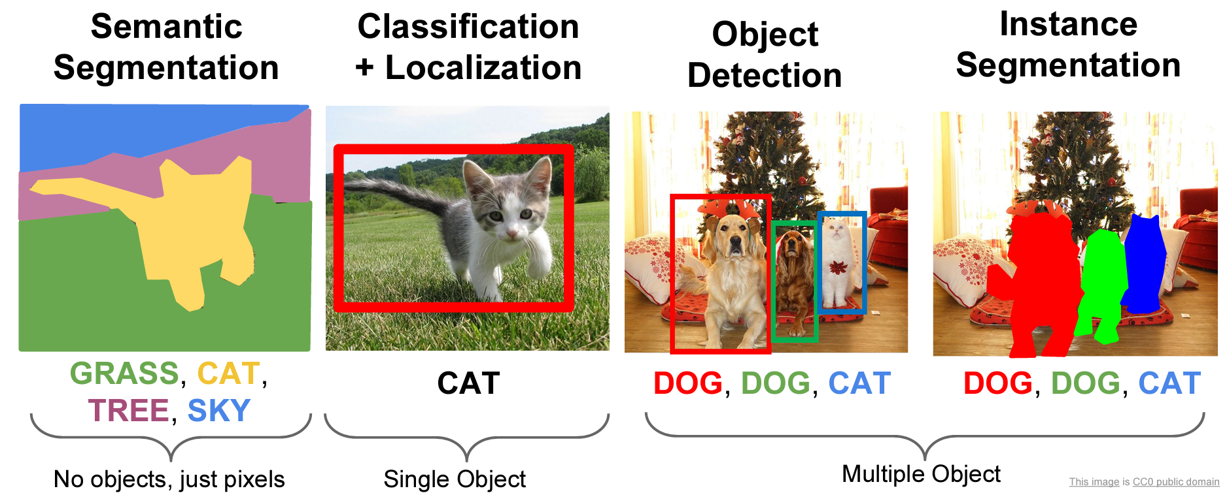
CNNs used for computer vision (analyzing images, videos)
Source: Stanford (CS231)

Slide 17
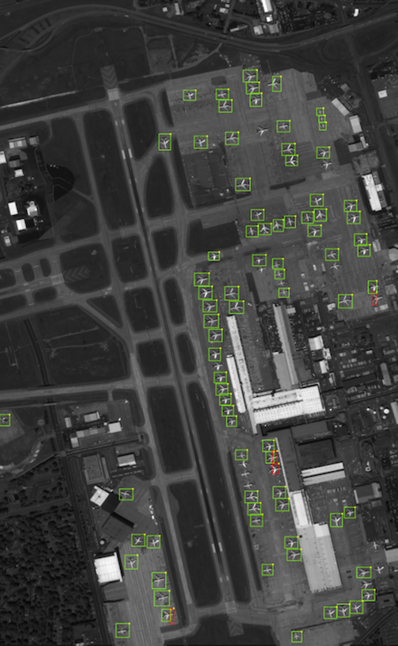
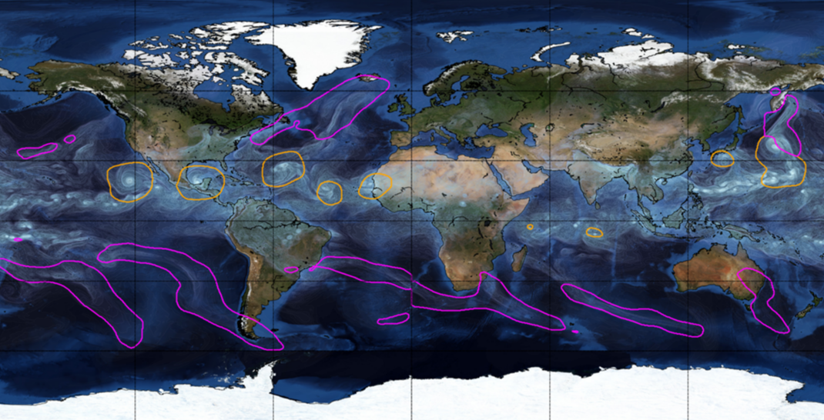
Object Detection for Remote Sensing
Instance Segmentation for Storm Detection
Source: Zhu et al. (2017), Prabhat et al. (2020)

Slide 18

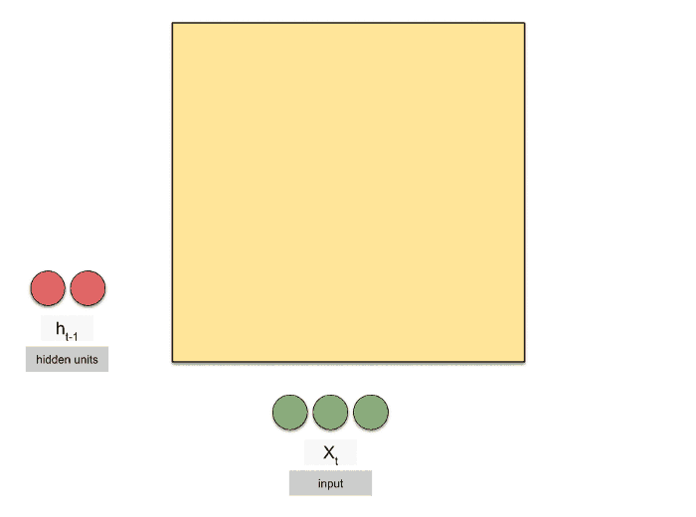
Last week: Recurrent Neural Networks (RNNs)
Regularized versions of ANNs to process temporal sequences
Source: Michael Phi, Raimi Karim (Towards Data Science)

Slide 19
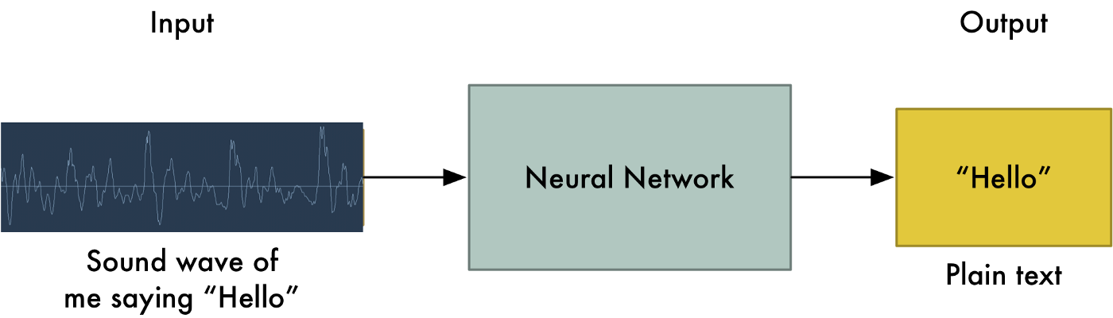

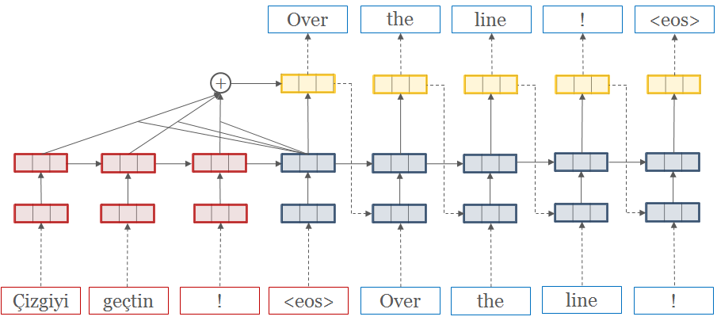
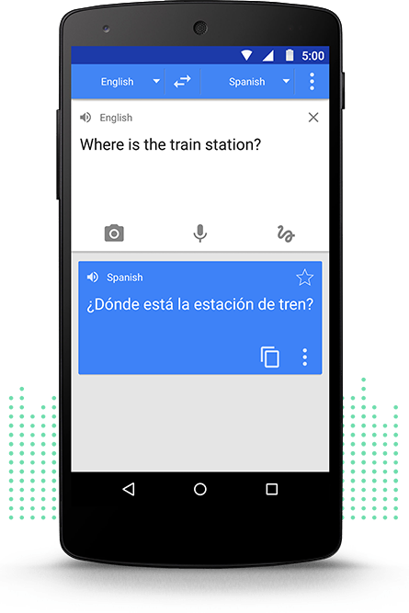
RNNs used to process temporal sequences
Speech Recognition
Machine Translation
Source: Adam Geitgey (Medium), opennmt.net, Google Translate

Slide 20
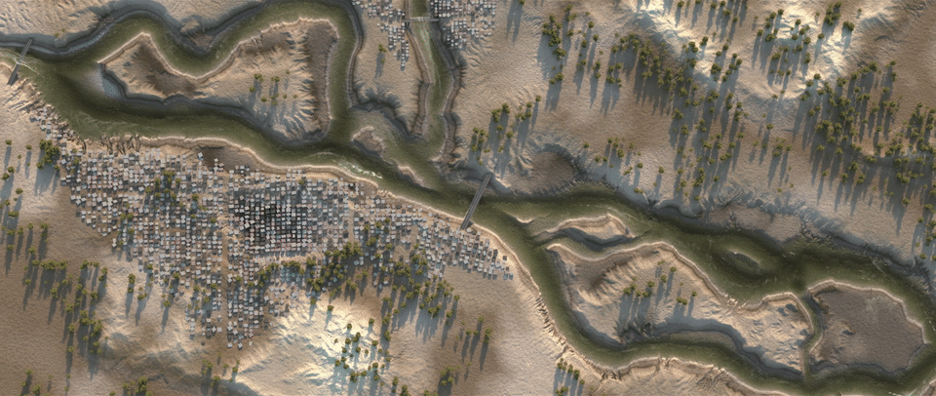
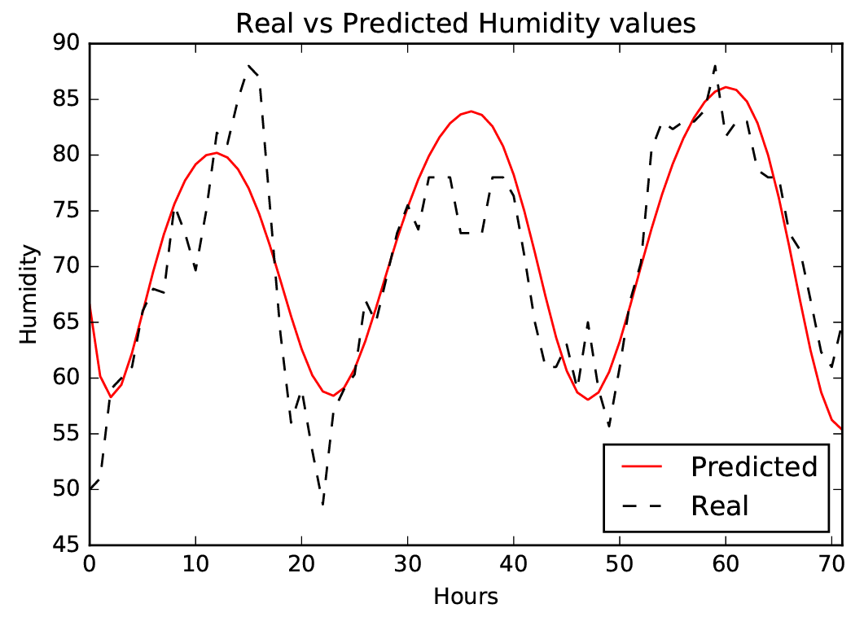
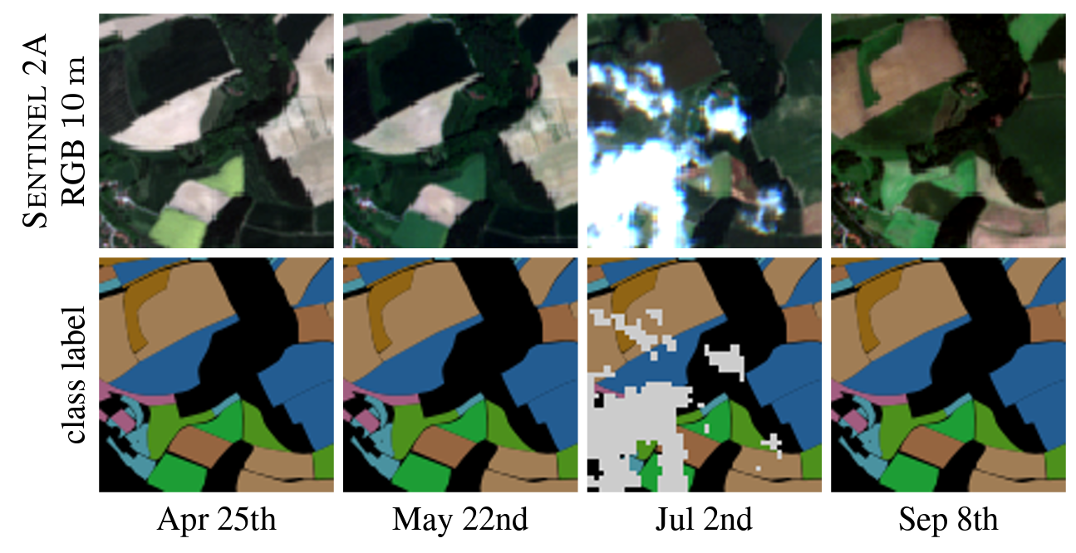
Catchment-independent rainfall-runoff models
Dynamic Time-Series Modeling
Dynamic Land Cover Classification
Source: Nadav Peleg (UNIL), Zaytar and El Amrani (2016), Russwurm et al. (2017)

Slide 21


Notes:
And at this point, it may bring back a lot of harsh memories trying to wrap your head around complex models….
Does *not* change the complexity of the model but changes the focus to explaining individual predictions

Slide 22
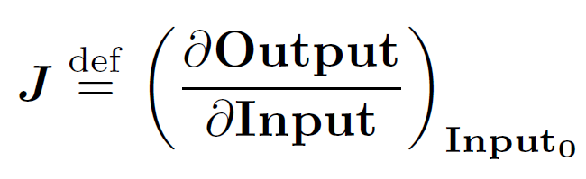
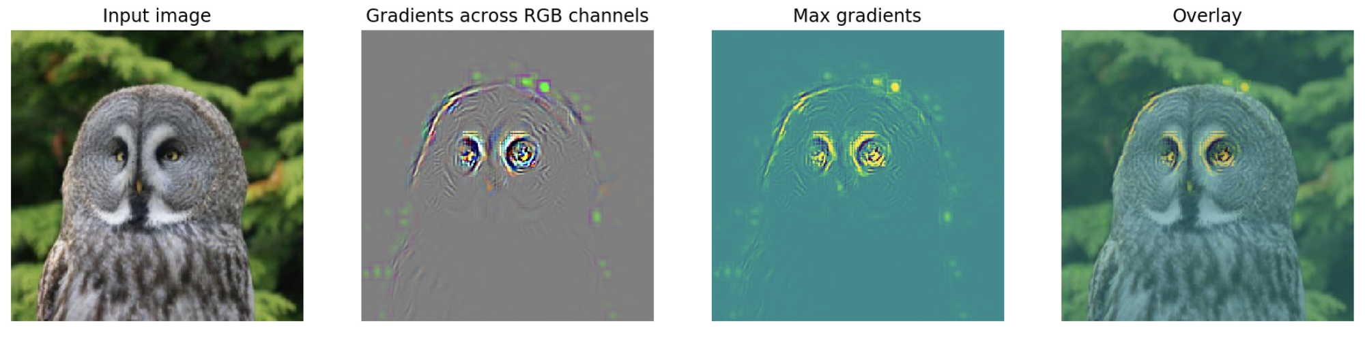
Saliency Map = Squared Jacobian of the emulated mapping
Deep learning libraries efficiently calculate Jacobian via automatic differentiation
Image source: flashtorch (Github) See: Paszke et al. (2017), Springenbert et al. (2015)
Notes:
And at this point, it may bring back a lot of harsh memories trying to wrap your head around complex models….
Does *not* change the complexity of the model but changes the focus to explaining individual predictions

Slide 23
Questions
Is there a difference between interpretability and explanation ?
I didint understand the question 9.2.1
Is it possible to have an example of other problem for vanilla gradient ?
Do you think that the explanations should focus on the abnormal?
do you have an example of (n>2)D PDP environmental application?
I didn't get the vanilla gradient.

Slide 24
Min 45-60: Moodle Quiz (5 questions, 15 min)
Learning Objectives (Molnar extracts):
Understand the importance of XAI
Distinguish local from global explanation methods
Distinguish model-agnostic from model-specific methods
Know how to implement permutation feature importance and partial dependence plots
Apprehend explanation methods for neural networks
Notes:
Questions?
Not graded

Slide 25


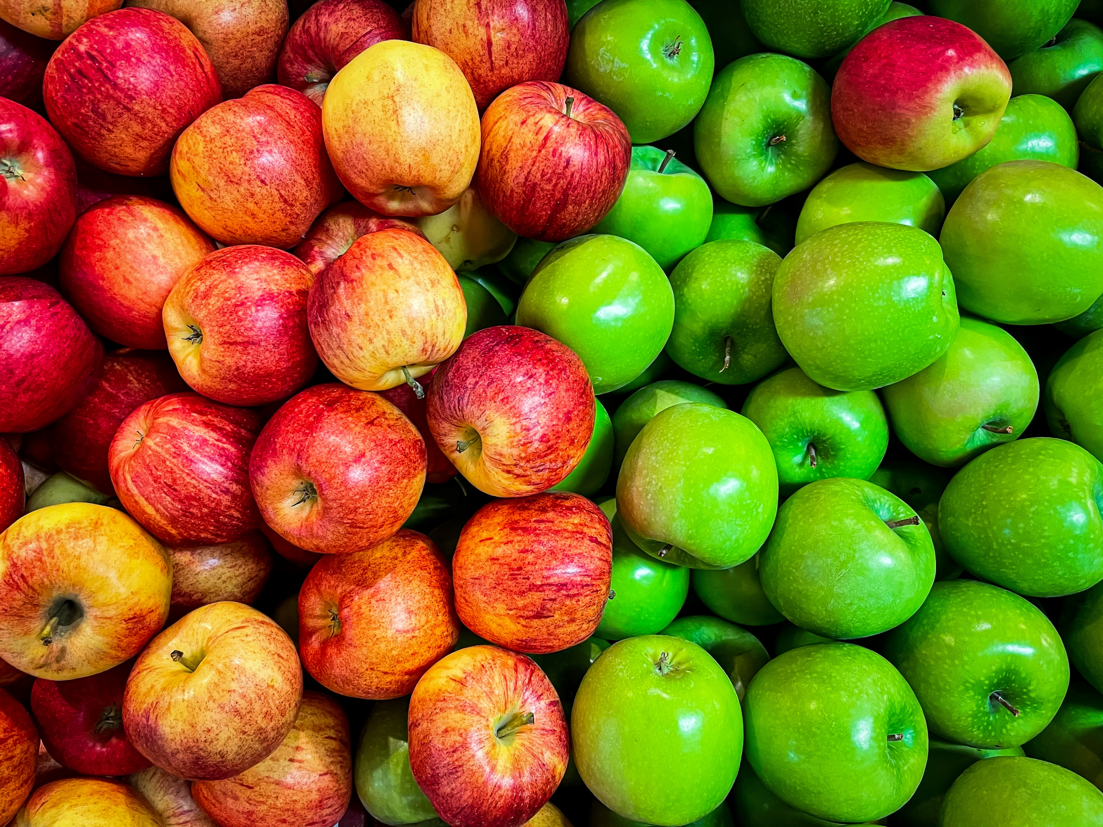
Min 60-75: Break

Slide 26
Questions
Maybe you could explain the difference between the logistic mean vs the logistic PCA as evaluations of the model?
I'm not sure to have understand why in this case it's so important to be able to interpret the model ?
ConvNet is not really clear
for hailstorms, is it easier or harder to focus on a smaller location (Switzerland or the border of the Geneva lake) or to work on larger scales (USA)?
What are your own thoughts on the interpretability/transparency and reproducibility of this paper's findings?

Slide 27
Min 105-120: Review Moodle Quiz
Learning Objectives (Molnar extracts):
Understand the importance of XAI
Distinguish local from global explanation methods
Distinguish model-agnostic from model-specific methods
Know how to implement permutation feature importance and partial dependence plots
Apprehend explanation methods for neural networks
Notes:
Questions?
Not graded

